Slide 1


Data-Driven Storytelling Presentation: Descriptive Analytics

Slide 2
Yearwise sales by account type
Account type of Online Retailer have shown great sales each year, specially in 2021 comparing to other account types.

Slide 3
Comparing Market Campaigns

Slide 4
From the given combo charts of Social media, Catalog Inclusion, Coupons and Posters; we have found the following conclusion:
Many account holder have chosen for Catalog Inclusion but it's average 5 year CAGR with 57.55% which is much less than other marketing campaigns. Meanwhile rate of return is more in social media with 97.47%, followed by Coupons with 66.70% which is way less than social media and then Posters with 61.37%. So, the most effective way of marketing is Social media.

Slide 5
Comparing Yearly Sales
As we can see, sales in 2021(red color) have drastically changed after a point and have kind off constant line after a point, though it have some low point but somehow it is moving in the same range of figures.

Slide 6
Top 10 sales by 5 year CAGR
Given Account name with top 10, 5 year CAGR having more than 100% CAGR. SB 13 have more rate of return with 334.98% , following by MB 5 with 224.56%.

Slide 7
City-wise CAGR & Average Sales
Rate of return is more in Yonkers even though the sales is 2% which is 4816.8 in five years. Even though the New York have earned a great sales but it’s rate of return is very less.

Slide 8
We can observe that cities such as New York and Brooklyn have earned great number of sales but it’s rate of return is very less in 5 years.
But Bronx have performed as per expectations.
Even though, Yonkers and Staten Island have very less number of sales, it still showed much better rate of return as compared to big cities such as New York and Brooklyn.

Slide 9
Account Types Total Sales
As anticipated, online retailers have generated greater revenue compared to other account kinds. Online retailing has potential of rapid growth with good marketing strategy.

Slide 10
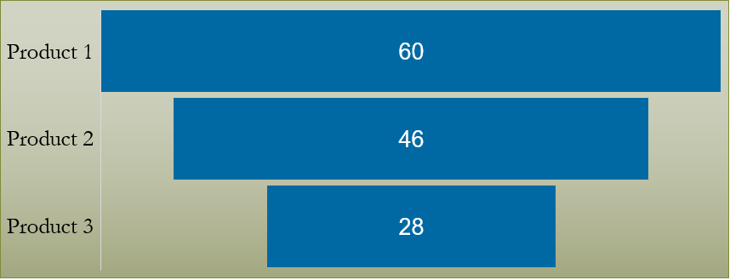
Flow of Product Lines dropoff
From this chart, we can see the largest absolute gap was between Product 2 and Product 3 on the product lines.

Slide 11
Summary
Cross-selling of Product 3 decreased in a very less number.
With sound marketing tactics, online retail has the potential to expand quickly.
Though the sales in big cities is higher but the rate of return is higher in Yonkers and Staten Island.
Account Name with SB 13 have CAGR of 334.98% even though it has Small Business and from Brooklyn, followed by MB 5 with 224.56% CAGR.
Sales in 2017 have gradually decreased to 0 as the rate of return increased and vice versa for Sales in 2021.
We have also found that Social Media is the most effective way for marketing as our inbound traffic is not only limited to your usual customers.
Also, the online retailer have shown great number of sales in each year as compared to other account types.

